Slide 1

Finding the most similar textual documents by using Case-Based Reasoning
Marko Mihajlović, Jesús Álvarez Domínguez,
Caterina Muntaner, Ermal Bizhuta

Slide 2
Content
• Introduction
• Datasets
• Feature extraction
• Similarity metrics
• Results

Slide 3
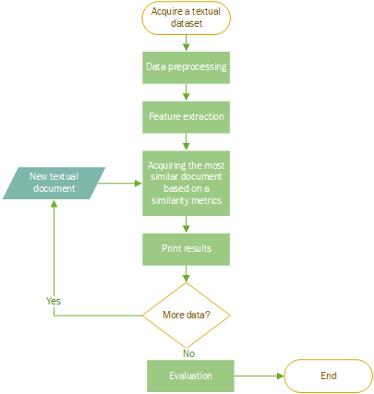
• Case-based reasoning (CBR) is an intelligent-systems method for identifying clusters of similar events in large databases.
• Our objective is to develop case-based reasoning system that is capable of acquiring the most similar textual document from a set of documents.
Notes:
The work flow diagram shown in the figure describes the retrieval process of relevant cases when a new case is entered into the system as a query case.
Then, the system initiates the process. The data starts to be preprocessed .The algorithm then decomposes the whole textual information into sentences, and then into individual words to reduce textual cases into term vectors. Due to huge amount of words a filtering process is required to improve the effectiveness of the retrieval. Therefore, very infrequent or very frequent terms, also stop-words and special characters are eliminated and the text is ready for stemming.
Finally, the three similarity methods, are applied. Cosine similarity, Euclidean distance, triangle sim function is applied to provide a list of relevant cases to the user .
In order to retain a case the same steps are repeated, if we have more data.

Slide 4
Datasets
20 Newsgroups collection [1]
Reuters dataset [2]
Reference to the document_id number
File (list.csv)
Newsgroup it is associated with
[1] http://qwone.com/~jason/20Newsgroups/
[2] http://trec.nist.gov/data/reuters/reuters.html
Notes:
As Ermal said, the first step is to acquire some data
We have used two well known datasets in data mining

Slide 5
20 Newsgroups collection
Comprises around 18000 newsgroups posts on 20 topics split in two subsets: one for training and the other one for testing
The split between the train and test set is based upon messages posted before and after a specific date.
Some of the 20 topics are:
comp.graphics
rec.motorcycles
sci.electronics
sci.med
sci.space
talk.politics.guns
alt.atheism
...
Notes:
The first one is 20 NesGroups collection, which consist of 18 000 newsgroups posts. Where each document belongs to one of 20 topics. Topics are about computer graphics, politics, space, medicine, war, etc.

Slide 6
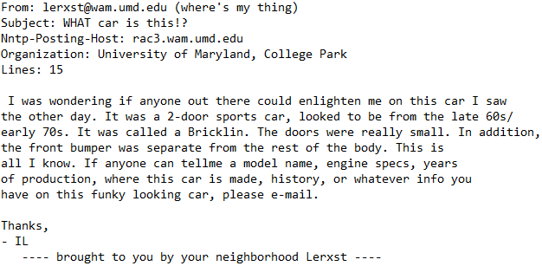
20 newsgroups collection - example of a document
Notes:
This is an example of a document. Suso is going to talk which words we have kept, and which are discarded

Slide 7
Reuters dataset
Reuters Corpus
Contains 10,788 news documents
In total 1.3 million words.
Documents classified into 90 topics,
Grouped into two sets(training, test)
Notes:
2) In contrast to the first dataset, the second dataset is smaller, but it has more categories, 90
So, the next step is to do some data preprocessing

Slide 8
Data preprocessing
Lowercase
Removing “stop words” [is, are, the, a, there, also, ...]
Ignoring terms that appear in less than 1% of the documents
Ignoring terms that appear in more than 50% of the document
Words shorter than 3 characters are discarded
Removed emails, websites
Only text is kept
WordNet lemmatizer is applied on each word

Slide 9
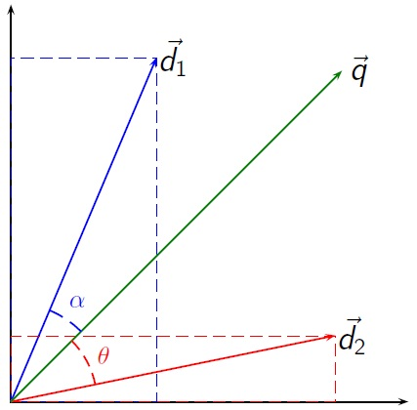
Feature extraction
Once the text preprocessing is done, the vocabulary is constructed. It consists of M words
Then, Vector space model is used for representing text documents as numerical vectors (d1,d2, …, dn)
Each document dn and each query q consist of M attributes.

Slide 10
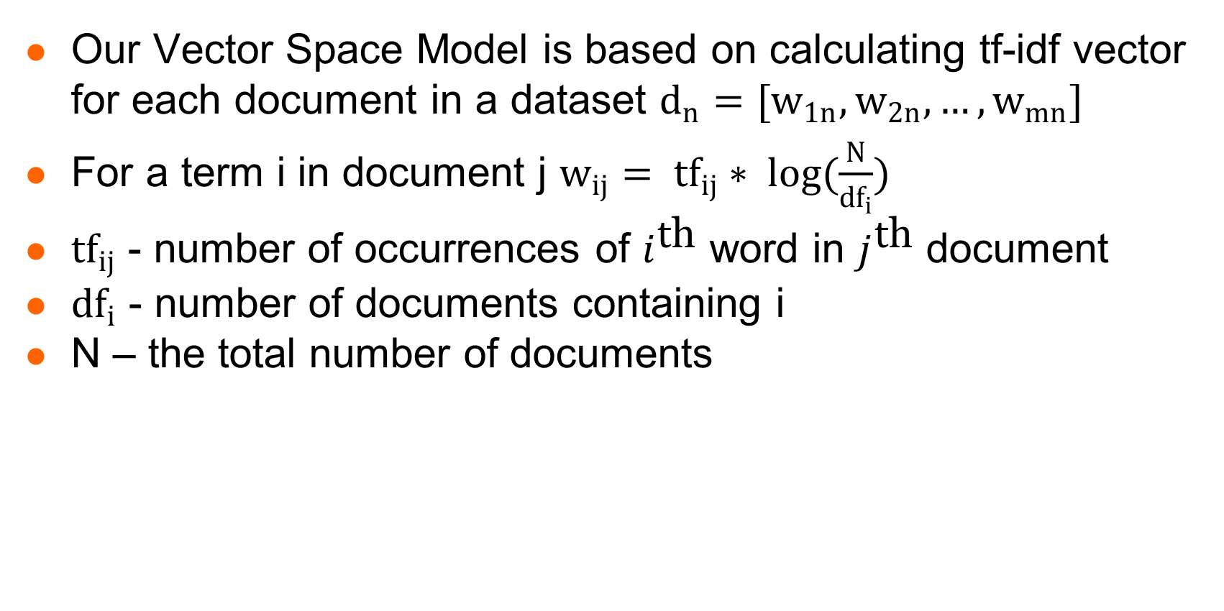
Feature extraction
Our Vector Space Model is based on calculating tf-idf vector for each document in a dataset $d_{n}=[w_{1n},w_{2n}, …,w_{mn}]$
For a term i in document j $w_{ij}= {tf}_{ij}∗ \log{(\frac{N}{{df}_{i}})}$
${tf}_{ij}$ - number of occurrences of $i^{\text{t}\text{h}}$ word in $j^{\text{t}\text{h}}$ document
${df}_{i}$ - number of documents containing i
N – the total number of documents

Slide 11
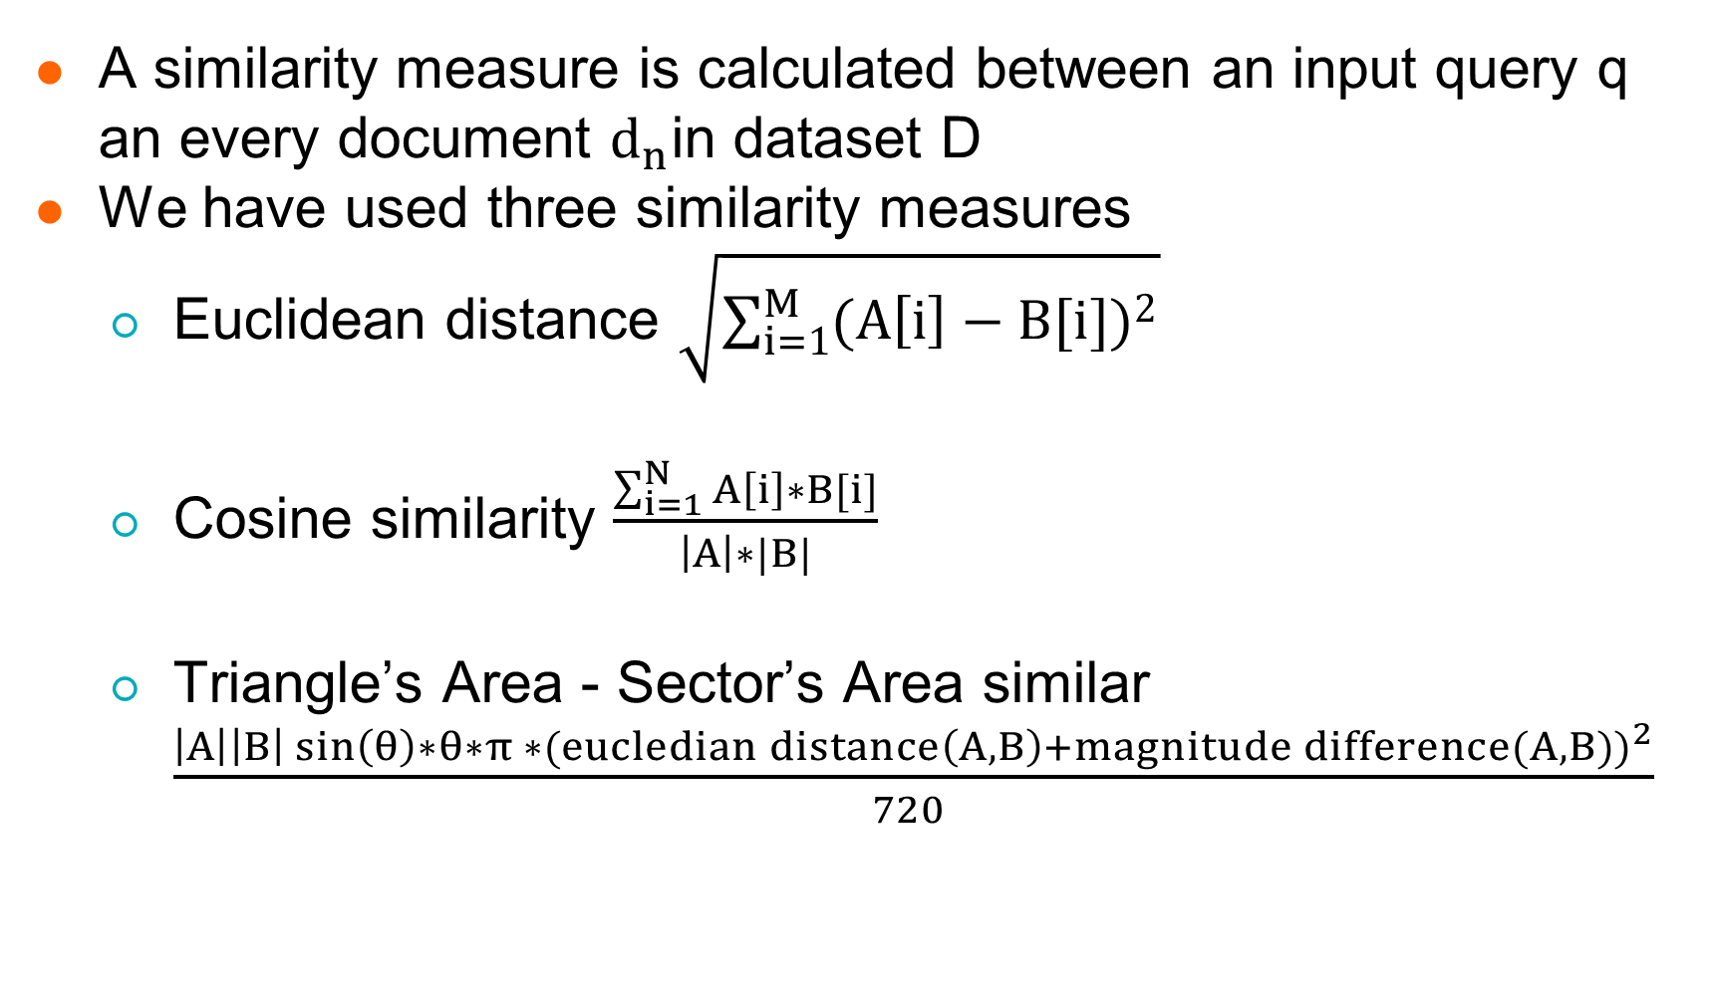
Similarity metrics
A similarity measure is calculated between an input query q an every document $d_{n}$in dataset D
We have used three similarity measures
Euclidean distance $\sqrt{\sum_{i=1}^{M}{{(A\left[i\right]−B[i])}^{2}}}$
Cosine similarity $\frac{\sum_{i=1}^{N}{A\left[i\right]∗B[i]}}{\left|A\right|∗|B|}$
Triangle’s Area - Sector’s Area similar $\frac{\left|A\right|\left|B\right|\sin\left(θ\right)∗θ∗π ∗{(eucledian distance\left(A, B\right)+magnitude difference(A, B))}^{2}}{720 }$

Slide 12
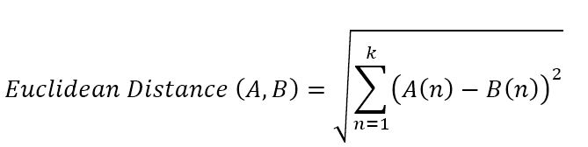
Method #1 : Euclidean Distance
Representing each text as a n dimension vector
Highest similarity between documents occurs when the two vectors are the same.

Slide 13
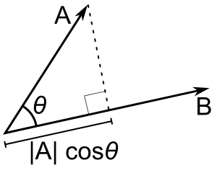
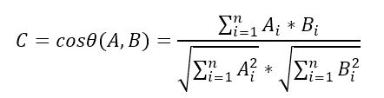
Method #2 : Cosine similarity:
Geometrical method which focuses on the angles of the two vectors
Range of similarity goes between 0 and 1.

Slide 14
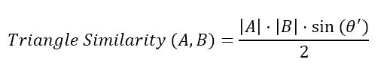

Method #3 : TS-SS
The triangle similarity compares the two vectors considering the Euclidian distance and the angle difference between vectors by calculating the area of the triangle created between the 2 vectors and using it as a similarity measure.
We calculate the TS similarity as:
Weakness: it doesn’t consider magnitude difference

Slide 15
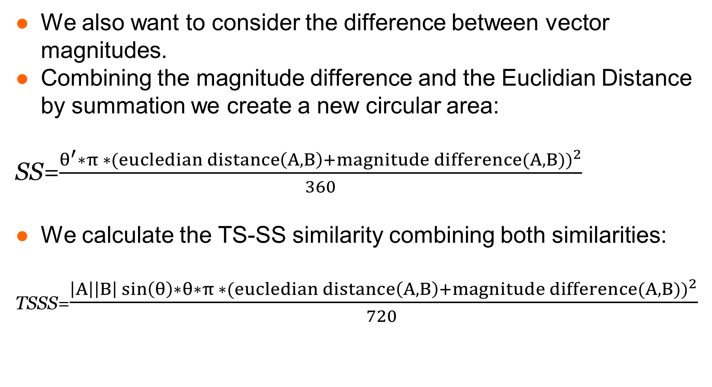
Method #3 : TS-SS
We also want to consider the difference between vector magnitudes.
Combining the magnitude difference and the Euclidian Distance by summation we create a new circular area:
SS=$\frac{θ^{′}∗π ∗{(eucledian distance\left(A, B\right)+magnitude difference(A, B))}^{2}}{360}$
We calculate the TS-SS similarity combining both similarities:
TSSS=$\frac{\left|A\right|\left|B\right|\sin\left(θ\right)∗θ∗π ∗{(eucledian distance\left(A, B\right)+magnitude difference(A, B))}^{2}}{720 }$

Slide 16
Results
Notes:
The results we got are very different from what we expected is going to happen.
The authors who introduced TSSS similarity metrics claim that their metrics performs better than the other ones
It requires further investigation.

Slide 17
Thank you for your attention. Questions?

